Slide 1

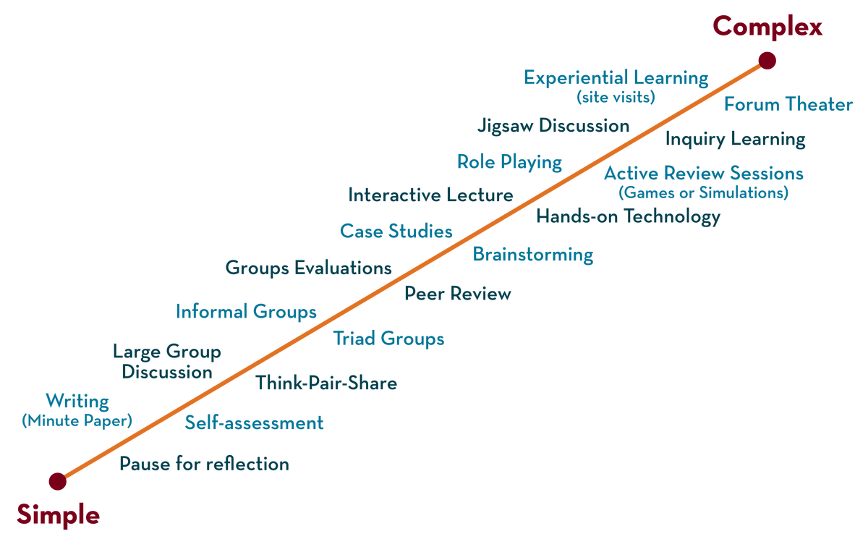
Department of CSE
Cloud & devops (EPAM)
21cs3019aa
Topic:
Devops FUNDAMENTALS
Session - 1

Slide 2
What is DevOps?
DevOps word in itself is a combination of two words one is Development and other is Operations. It is neither an application nor a tool; instead, it is just a culture to promote development and Operation process collaboratively. As a result of DevOps implementation, the speed to deliver applications and services is increased.
DevOps enables organizations to serve their customers strongly and better in the market. In other words, we can say that DevOps is the process of alignment of IT and development operations with better and improved communication.

Slide 3
Where did DevOps come from?
There are tons of stories about the DevOps origins, but it is not created out of the whole cloth. Its seeds were planted many years ago and recently nurtured by expert IT professionals in several disciplines. Two primary ancestors of DevOps are given below:
ESM (Enterprise Systems Management): People involved in the initial phases of DevOps are system administrators. These experts brought the key ESM practices to DevOps like configuration management, automated provisioning, system monitoring, and the toolchain approach, etc.
Agile Development: DevOps can be considered as an outgrowth of the agile. It is simply extending the Agile principles beyond boundaries of the code to the entire delivered services.

Slide 4
What problems led to the creation of DevOps?
DevOps implementation has increased the rate of software delivery and the revenue for business stakeholders. Following listed reasons are the most considerable ones that led to the creation of DevOps.
Before DevOps, operation and development teams were working in an isolated environment.
Testing and Deployment activities mostly were performed in an isolated manner after design-build step, and they took more time than actual project completion time.
Team members usually spend a large amount of time in deploying, testing, designing, and building the projects
Human production errors were deployed during manual code conduction.
Operations and coding teams generally had different timelines and did not have proper synchronization that results in further delay.
To avoid the hassles mentioned above and non-collaborative performance measures, there was an urgent need for robust IT technology like DevOps to satisfy business owners and stakeholders.

Slide 5
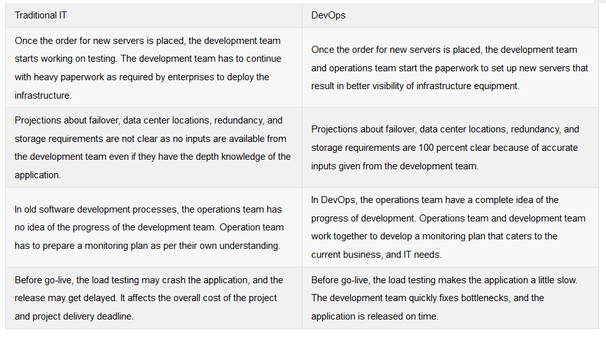
How is DevOps different from Traditional IT?

Slide 6
Following are the factors that will improve as a result of DevOps implementation
Predictability: DevOps decreases the failure rate of new product releases.
Maintainability: The process improves the overall recovery rate at the time of the release event.
Improved Quality: DevOps improves the quality of product development by incorporating infrastructure issues.
Lower Risk: Security aspects are incorporated in SDLC, and the number of defects gets decreased across the product
Cost Efficient: Cost efficiency is improved due to DevOps that is always an aspiration of every business organization.
Stability: DevOps implementation offers a stable and secure operational state.
Streamlined Delivery Process: As DevOps provides streamlined software delivery, so marketing effort is reduced up to 50%. It happens due to the mobile application and digital platform.

Slide 7
i). Development
This is the first stage of DevOps lifecycle in which development of application takes place constantly. The entire development process is broken down into small steps or development cycles. As a result of this, the speed of software development and delivery is increased.
ii). Testing
Selenium like testing tools is used to speed up the overall testing process by quick identification of errors and fixing the bugs.
iii). Integration
New functionalities are integrated with the prevailing code, and testing of new code takes place. Continuous integration and testing help in the continuous development process.
iv). Deployment
Continuous deployment is the part of DevOps lifecycle. When it is performed in the right way, then it can affect the overall functioning of a high traffic website.
v). Monitoring
Inappropriate system behavior is managed by monitoring. Through proper monitoring, the bugs are found and fixed in a hassle-free way.
These are the building blocks for any DevOps application. As per DevOps culture, a group of Engineers is responsible for each stage of DevOps application development, including developer, system admin, testing, and others.

